Slide 1
Survey of software architectures

Slide 2
Survey of software architectures
•We are going to discuss the four basic software approaches we can implement in an embedded systems.
• A software architecture is just how our source code is arranged.
• The most important factor that determines which architecture will be the most appropriate is how much control you need to have over system response.
• A system that must respond rapidly to many different events ought to be implemented very differently from a system with just a single event and very small response time.
• Four architectures: round-robin, round-robin with interrupts, function-queue-scheduling, and real-time operating system.

Slide 3
Round robin
The Loop or Round Robin Scheduler is a single execution thread that runs repeatedly.
Systems that run in loops can be either simple or large, but the key feature is that there are no context switches or background tasks that can alter the flow of execution.
As a result, these are best suited to simpler tasks that do not require fast response to external stimuli, or which can focus on that stimuli only..

Slide 4
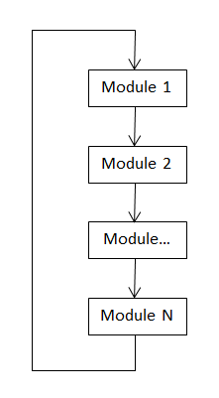
Round robin

Slide 5
Round robin
void main ()
{
while (TRUE)
{
if (!! I/O Device A needs service){
!! Take care of I/O Device A
}
if (!! I/O Device B needs service) {
!! Take care of I/O Device B
}
(...)
if (!! I/O Device Z needs service){
!! Take care of I/O Device Z
}
}//end while (TRUE)
Round-robin is the simplest
imaginable architecture.
• There are no interrupts.
• The main loop simply checks each of the I/O devices in turn and services any that need service.
• No interrupts, no shared
data, no latency concerns

Slide 6
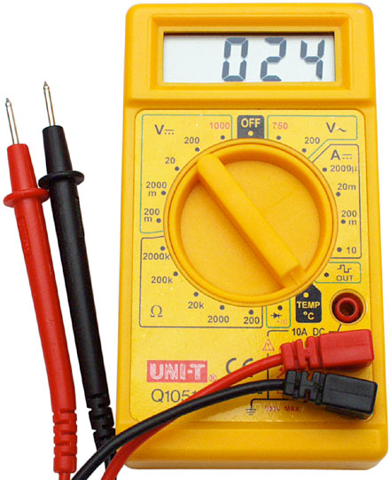
Round robin usage example
Software program for an embedded system that runs on digital multimeter.
A digital multimeter measures resistance or current or voltage in several different ranges.
A multimeter has two measuring probes, a digital display, and a big rotary switch that selects measurement and range.

Slide 7
Round robin inside a digital multimeter
• The system makes continuous
measurements and changes the
display to reflect the most recent
measurement.
• Each time around its loop, the
software checks the position of the
rotary switch, branches to the
appropriate code selection and
writes the results to the display.

Slide 8
Digital multimeter code
void vDigitalMultiMeterMain(){
enum {OHMS1,OHMS10,...VOLTS100) eSwitchPosition;
while (TRUE)
{
eSwitchPosition = !! Read switch position
switch (eSwitchPosition) {
case OHMS_1:
!! Read hardware to measure ohms
break;
case OHMS_10:
!! Read hardware to measure ohms
break;
(...)
case VOLTS_100:
!! Read hardware to measure volts
break;
}
!! Write result to display
}
}

Slide 9
Problems with round robin
• Round-robin architecture has only one advantage over other
architectures: simplicity!
• It has some problems that make it inadequate for many systems:
1. If any one device needs response in a limited time, the system may not work.
2. The system can respond really slow.
3. The architecture is very susceptible to code changes.
• Because of these shortcomings, a round-robin architecture is probably suitable only for very simple devices .

Slide 10
Problems with round robin
• If you need fast response time round robin is not the way to go
• Slow system response
• Round robin is a fragile architecture(Adding a single additional device may break everything)

Slide 11
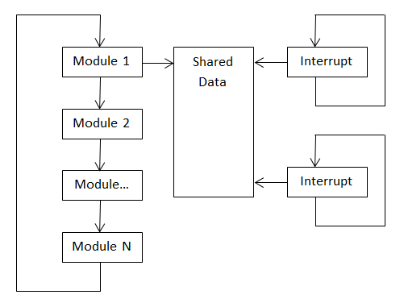
Round robin with interrupts

Slide 12
Round robin with interrupts
The Round-robin Scheduler with Interrupts is the most common form of small operating system. It is enormously flexible and provides fast response to external hardware signals with guaranteed internal time management.
For small systems up to 10K lines of code this format of operating system is our usual starting point because there is almost nothing it won’t handle if designed correctly

Slide 13
Round robin with interrupts
Interrupt routines deal with the very urgent needs of the hardware and then set flags.
• The main loop polls the flags and does any follow-up processing required by the interrupts.
• This architecture gives you more control over priorities, since the processor can now stop the main loop and resolve the interrupts.

Slide 14
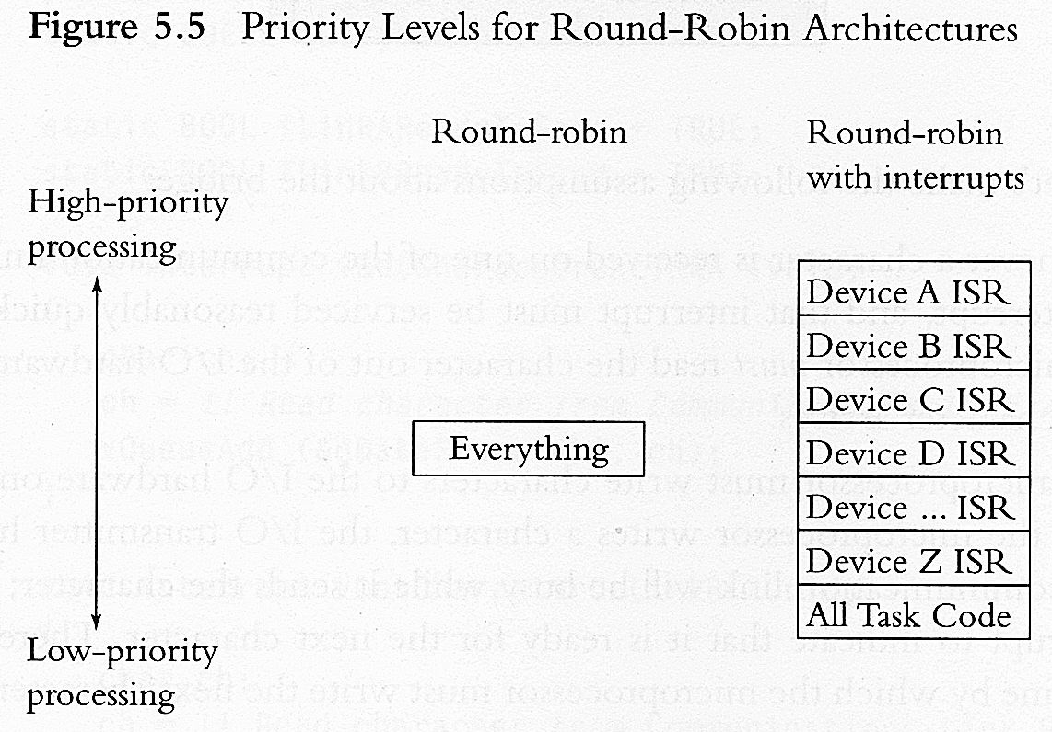
Comparing round robin with interrupts and without interrupts
• Advantages: Same advantages of use interrupts over polling (priority control).
• Disadvantages: a lot of data is shared amongst many different interrupt routines which will potentially create shared data problems.

Slide 15
Round robin with interrupts example
BOOL fDeviceA = FALSE;
BOOL fDeviceB = FALSE;
(...)
BOOL fDeviceZ = FALSE;
void interrupt vHandleDeviceA ()
{
!! Take care of I/O Device A
fDeviceA = TRUE;
}
void interrupt vHandleDeviceB ()
{
!! Take care of I/O Device B
fDeviceB = TRUE;
}
void interrupt vHandleDeviceZ ()
{
!! Take care of I/O Device B
fDeviceB = TRUE;
}
void main ()
{
while (TRUE) {
if (fDeviceA){
fDeviceA = FALSE;
!! Handle I/O Device A
}
if (fDeviceB){
fDeviceB = FALSE;
!! Handle I/O Device B
}
(...)
if (fDeviceZ){
fDeviceZ = FALSE;
!! Handle I/O Device Z
}
} //end of while (TRUE)
}

Slide 16
Round robin with interrupts example
• Whenever an I/O is ready, an interrupt will occur.
This interrupt will set a Boolean variable which mentions that some I/O operation needs to be done.
The main loop checks the Boolean variable to see if there is some I/O operation that needs to be done.

Slide 17
Round robin with interrupts
This looks same as normal round robin.
The point is that we can add “important” task code into the interrupt service routine.
This will guarantee that “important devices” are dealt first.
The problem is that, the lower priority devices will suffer increased response times.

Slide 18
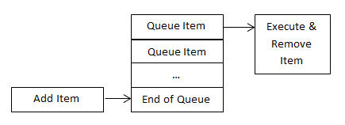
Function-Queue-Scheduling

Slide 19
Function-Queue-Scheduling
In RR-I urgent tasks get handled in an interrupt service routine, possibly with a flag set for follow-up processing in the main loop. If nothing urgent happens (emergency stop button pushed, or intruder detected), then the processor continues to operate round robin, managing more mundane tasks in order around the loop. ISR always has priority over the main loop
Function queue scheduling provides a method of assigning priorities to interrupts.
In this architecture, interrupt service routines accomplish urgent processing from interrupting devices, but then put a pointer to a handler function on a queue for follow-up processing.
The main loop simply checks the function queue, and if it’s not empty, calls the first function on the queue.

Slide 20
Function-Queue-Scheduling
Priorities are assigned by the order of the function in the queue – there’s no reason that functions have to be placed in the queue in the order in which the interrupt occurred. They may just as easily be placed in the queue in priority order: high priority functions at the top of the queue, and low priority functions at the bottom.
The worst case timing for the highest priority function is the execution time of the longest function in the queue (think of the case of the processor just starting to execute the longest function right before an interrupt places a high priority task at the front of the queue).

Slide 21
Function-Queue-Scheduling
The worst case timing for the lowest priority task is infinite: it may never get executed if higher priority code is always being inserted at the front of the queue.
The advantage to function queue scheduling is that priorities can be assigned to tasks; the disadvantages are that it’s more complicated than the other architectures discussed previously, and it may be subject to shared data problems.

Slide 22
Real Time Operating System
What is Embedded System???
An embedded system is a special-purpose computer system designed to perform one or a few dedicated functions, often with real-time computing constraints. Embedded systems contain a processor, software and Memory and The processor may be 8051micro-controller or a Pentium-IV processor, Memory ROM and RAM respectively Memory Input Processor Output.
Embedded systems also contain some type of inputs and outputs Inputs to the system generally take the form of sensors and probes, communication signals, or control knobs and buttons. Outputs are generally displays, communication signals, or changes to the physical world. Example microwave oven, air conditioner, ATM machine etc…

Slide 23
Real Time Operating System
Real-time embedded systems is one major subclass of embedded systems and time is most important part for this type of system.
Example
Scientific Experiments
Medical Imaging Systems
Industrial Control Systems
Weapon Systems
Robots
Home-appliance Controllers
Air Traffic Control System.
Industrial control systems
Food processing
Engine Controls

Slide 24
Real Time Operating System
Those systems in which the correctness of the system depends not only on the logical result of computation, but also on the time at which the results are produced.
A real time system is a system/that ensures the exact time requirements for a job.

Slide 25
Real Time Operating System
Real time system is defines as a data processing system in which the time interval required to process and respond to inputs is so small that it controls the environment.
The time taken by the system to respond to an input and display of required updated information is termed as response time. So in this method response time is very less as compared to other operating system.

Slide 26
Type of Real Time Operating System
Soft Real Time System
In a soft real-time system, tasks are completed as fast as possible without having to be completed within a specified timeframe.
Hard Real Time System
In a hard real-time operating system however, not only must tasks be completed within the specified timeframe, but they must also be completed correctly.

Slide 27
Type of Real Time Operating System
Hard Real Time System
Hard real time means strict about adherence to each task deadline.
When an event occurs, it should be serviced within the predictable time in a given hard real time system.
The preemption period for the hard real time task in worst case should be less than a few micro seconds.
A hard RTOS is one, which has predictable performance with no deadline miss, even in case of sporadic tasks (sudden bursts of occurrence of events requiring attention).
Automobile engine control system, antilock brake and Video transmission, each picture frame and audio must be transferred at fixed rate are some of the examples of hard real time systems

Slide 28
Type of Real Time Operating System
Soft real time system
The system in which deadlines are mostly met.
Soft real time means that only the precedence and sequence for the task operations are defined, interrupt latencies and context switching latencies are small but there can be few deviations between expected latencies of the tasks and observed time constraints and a few deadline misses are accepted.
Example Mobile phone, Digital cameras and Orchestra playing robots are examples of soft real time systems.

Slide 29
Type of Real Time Operating System
Firm Real-Time Operating System
In the firm real-time, an operating system has certain time constraints, they are not strict and it may cause undesired effects.
Examples of this operating system are a visual inspection in industrial automation.

Slide 30
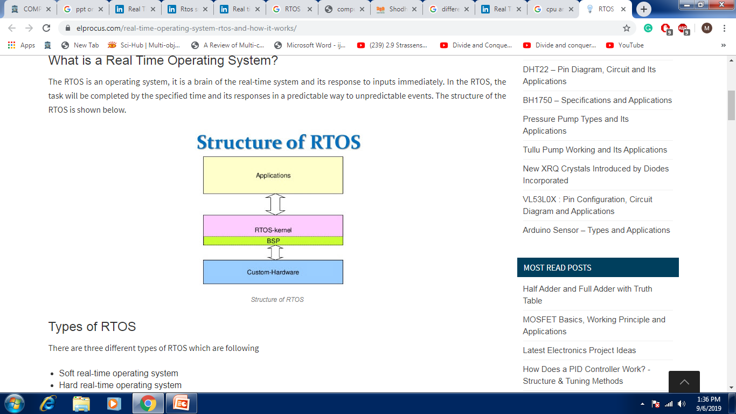
Structure of RTOS

Slide 31
Structure of RTOS
The most important component of RTOS is its kernel (Monolithic & Microkernel).
BSP or Board Support Package makes an RTOS target-specific (It’s a process or specific code onto (processor) which we like to have our RTOS running).

Slide 32
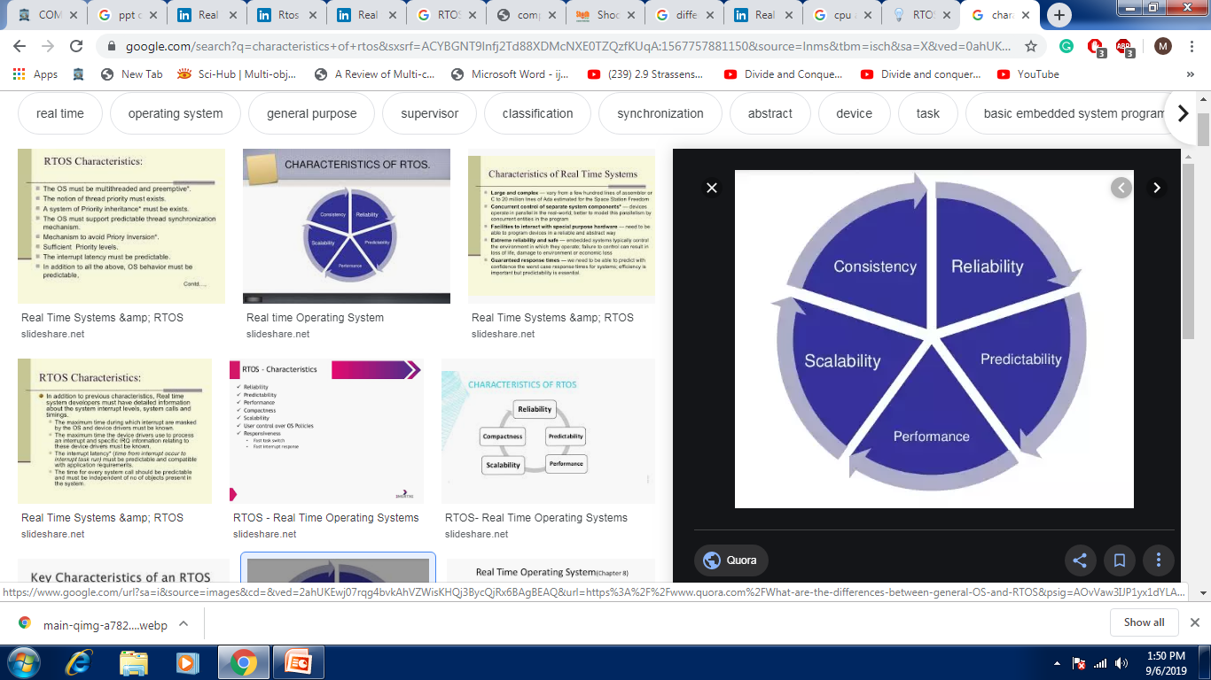
Characteristics of RTOS

Slide 33
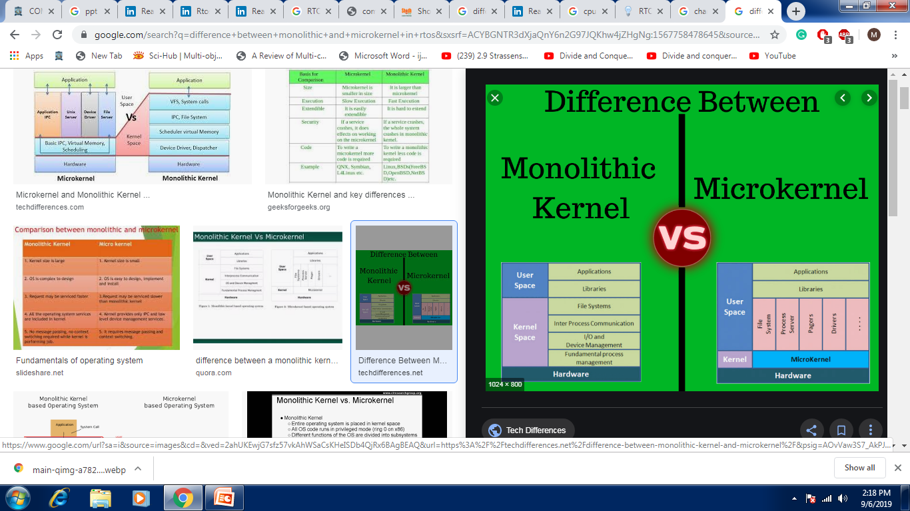
Structure Of Monolithic and Microkernel

Slide 34
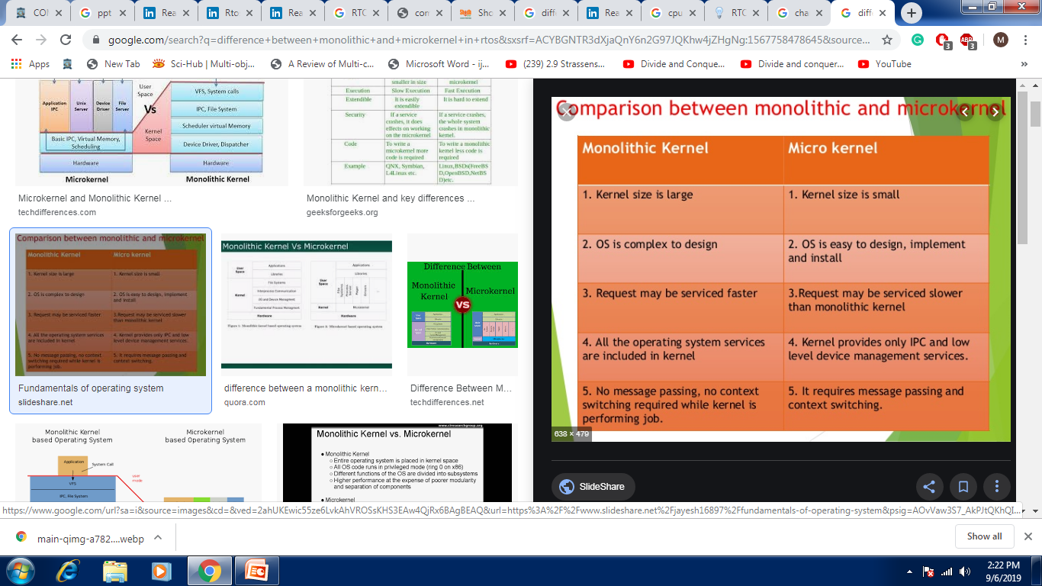
Difference between Monolithic and Microkernel

Slide 35
Features of RTOS’s
Scheduling.
Task Synchronization
Resource Allocation.
Interrupt Handling.
Other issues like kernel size.

Slide 36
Introduction To Task
The embedded software consists of no. of task.
The task object consists of its name, a unique ID, a priority, a stack and a Task Control Block.
The kernel has its own system tasks with priorities. These task are:
Startup task
Exception handling task
Logging task
Idle task
Each task has to be assigned priority; and a mechanism for deciding which task will get CPU time next has to be worked out. This is known as task scheduling.

Slide 37
Tasks and Task Scheduler
Another important requirement is that one task should not corrupt the data of another task. While scheduling the tasks, a number of issues as described below:
Many tasks make calls to a function.
Reentrant function( may be shared by several processes at the same time).
Non-reentrant function.
Every task requires resources.
Tasks may need to communicate data among themselves.

Slide 38
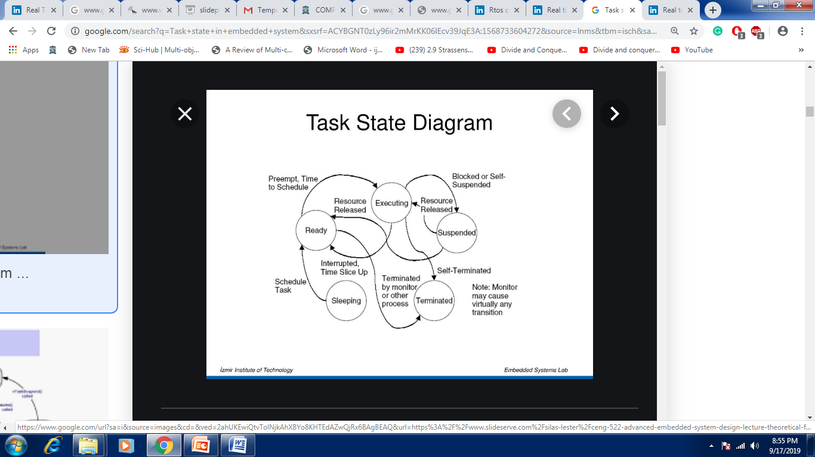

Slide 39
Task States
Idle : task has no need for computer time
Ready : task is ready to go active, but waiting for processor time
Running : task is executing associated activities
Waiting : task put on temporary hold to allow lower priority task chance to execute
suspended: task is waiting for resource

Slide 40
Task State
Each task/Process can belong to one and only one state.
The Scheduler only operates on the processes in the Ready state.
There is a single task in the Run/current state at any time.
Transitions to and from the Ready queue are affected as a part of the execution of the RTOS resource/object services or as a result of timing events

Slide 41
Task Operation
creating and deleting tasks,
controlling task scheduling,
obtaining task information.

Slide 42
Context Switching and Scheduling Algorithms
The state of the CPU registers when a task has to be preempted is called the context.
Saving the contents of the CPU registers and loading the new task parameter is called context switching.
Scheduling Algorithms Depending on the requirement of the embedded system, the scheduling algorithm needs to be chosen. Following scheduling algorithm:
First In First Out
Round Robin algorithm
Round Robin with priority
Shortest Job First
Non-preemptive multitasking
Preemptive multitasking

Slide 43
Task Scheduling
Time Slicing
Last
Arrival
Order
Task 3
Task 3
Task 2
Task 2
First
Task 1
Task 1
Time

Slide 44
Scheduling Algorithms
Clock Driven Scheduling
Weighted Round Robin Scheduling
Priority Scheduling
(Greedy / List / Event Driven)

Slide 45
Scheduling in RTOS
More information about the tasks are known
No of tasks
Resource Requirements
Release Time
Execution time
Deadlines
Being a more deterministic system better scheduling algorithms can be devised.

Slide 46
Scheduling Algorithms
First In First Out: The task which are ready to run are kept in a queue and the CPU serves the task on first come first served basis. This is a good algorithm for an embedded system has to perform few small tasks all with small execution times.
Round Robin Algorithm: The kernel allocates a certain amount of time for each task waiting in the queue. The time slice allocated to each task is called quantum. The kernel gives control to the next task if the current task has completed its work within the time slice. The current task has completed its allocated time slice. Digital multi-meters and microwave ovens use this algorithm.

Slide 47
Scheduling Algorithms
Round Robin Algorithm with Priority:
The round robin algorithm can be slightly modified by assigning priority levels to some or all the task. Examples: Bar Code Scanner Soft real-time systems can use this algorithm.
Shortest Job First.
In Shortest-job first task scheduling algorithm, the task that will take minimum time to be executed will be given priority. This approaches satisfies the maximum number of tasks, but some task may have to wait forever.

Slide 48
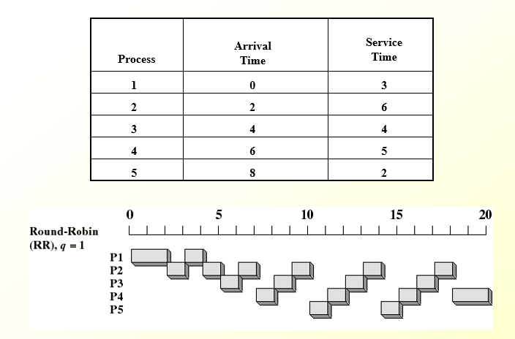
Example of Task scheduling (RR)

Slide 49
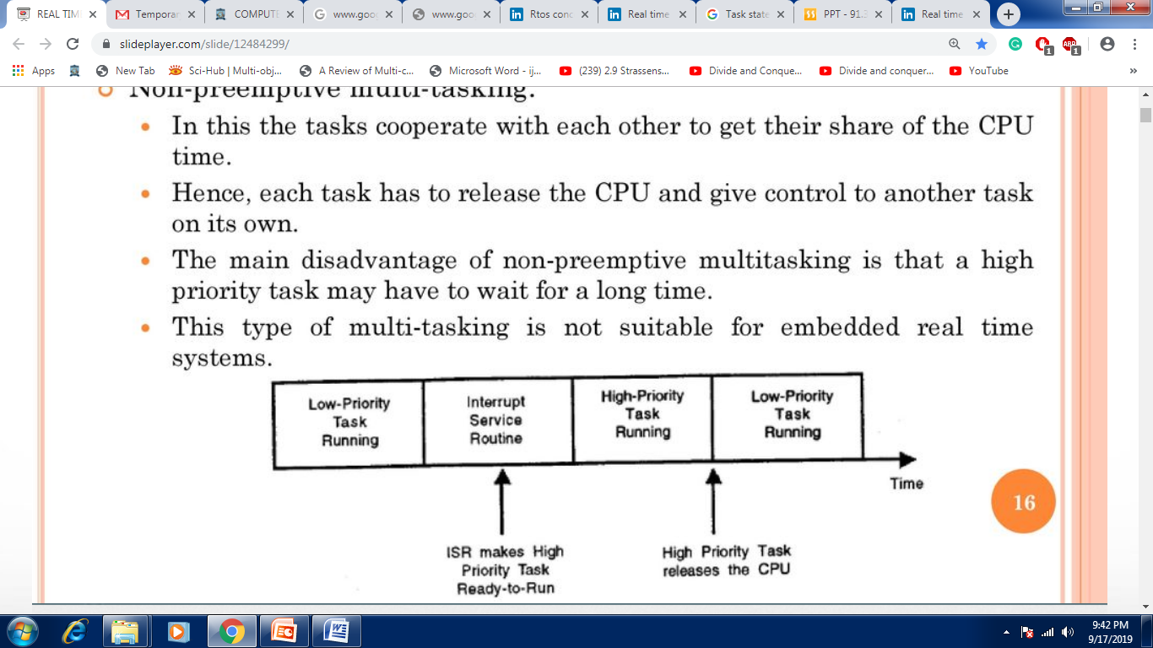
Scheduling Algorithms
The kernel used in embedded systems can implement priority-based multi-tasking scheduling algorithms of two types:
Non-preemptive multi-tasking.
Preemptive multi-tasking.
Non-preemptive multi-tasking.
In this the tasks cooperate with each other to get their share of the CPU time. Hence, each task has to release the CPU and give control to another task on its own.
The main disadvantage of non-preemptive multitasking is that a high priority task may have to wait for a long time. This type of multi-tasking is not suitable for embedded real time systems.

Slide 50
Scheduling Algorithms
Preemptive multi-tasking.
In preemptive multi-tasking, the highest priority task is always given the CPU time.
The main attraction of this scheme is that the execution time of the highest priority task can be calculated.
Most of the commercial embedded OS use preemptive multitasking to meet real time requirements.

Slide 51
Scheduling Algorithms in RTOS (contd)
Clock Driven
All parameters about jobs (release time/ execution time/deadline) known in advance.
Schedule can be computed offline or at some regular time instances.
Minimal runtime overhead.
Not suitable for many applications.

Slide 52
Scheduling Algorithms in RTOS (contd)
Weighted Round Robin
Jobs scheduled in FIFO manner
Time quantum given to jobs is proportional to it’s weight
Example use : High speed switching network
QOS guarantee.
Not suitable for precedence constrained jobs.
Job A can run only after Job B. No point in giving time quantum to Job B before Job A.

Slide 53
Scheduling Algorithms in RTOS (contd)
Priority Scheduling
(Greedy/List/Event Driven)
Processor never left idle when there are ready tasks
Processor allocated to processes according to priorities
Priorities
static - at design time
Dynamic - at runtime

Slide 54
Priority Scheduling
Earliest Deadline First (EDF)
Process with earliest deadline given highest priority
Least Slack Time First (LSF)
slack = relative deadline – execution left
Rate Monotonic Scheduling (RMS)
For periodic tasks
Tasks priority inversely proportional to it’s period

Slide 55
Task Synchronization
Events
Messages
Semaphores
Mutexes
Resource Allocation.
Mailboxes
Message Queues

Slide 56
Semaphores
Invented by Edgser Dijkstra in the mid-1960s
Offered by most multitasking kernels
Used for:
Mutual exclusion
Signaling the occurrence of an event
Synchronizing activities among tasks

Slide 57
Semaphores (cont.)
A semaphore is a key that your code acquires in order to continue execution
If the key is already in use, the requesting task is suspended until the key is released
There are two types
Binary semaphores
0 or 1
Counting semaphores
>= 0

Slide 58
Semaphore Operations
Initialize (or create)
Value must be provided
Waiting list is initially empty
Wait (or pend)
Used for acquiring the semaphore
If the semaphore is available (the semaphore value is positive), the value is decremented, and the task is not blocked
Otherwise, the task is blocked and placed in the waiting list
Most kernels allow you to specify a timeout
If the timeout occurs, the task will be unblocked and an error code will be returned to the task

Slide 59
Semaphore Operations (cont.)
Signal (or post)
Used for releasing the semaphore
If no task is waiting, the semaphore value is incremented
Otherwise, make one of the waiting tasks ready to run but the value is not incremented
Which waiting task to receive the key?
Highest-priority waiting task
First waiting task

Slide 60
Semaphore Example
Semaphore *s;
Time timeout;
INT8U error_code;
timeout = 0;
Wait(s, timeout, &error_code);
Access shared data;
Signal(s);

Slide 61
Applications of Binary Semaphores
Suppose task 1 prints “I am Task 1!”
Task 2 prints “I am Task 2!”
If they were allowed to print at the same time, it could result in:
I Ia amm T Tasask k1!2!
Solution:
Binary semaphore

Slide 62
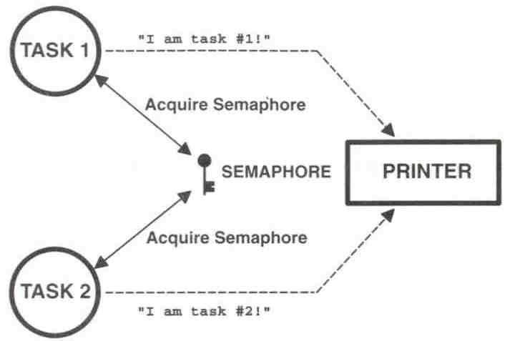
Sharing I/O Devices

Slide 63
Sharing I/O Device (cont.)
In the example, each task must know about the semaphore in order to access the device
A better solution:
Encapsulate the semaphore

Slide 64
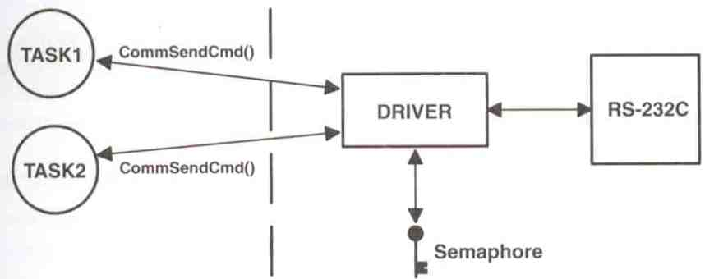
Encapsulating a Semaphore

Slide 65
Encapsulating a Semaphore (cont.)
INT8U CommSendCmd(char *cmd, char *response, INT16U timeout)
{
Acquire semaphore;
Send command to device;
Wait for response with timeout;
if (timed out) {
Release semaphore;
return error code;
} else {
Release semaphore;
return no error;
}
}

Slide 66
Applications of Counting Semaphores
A counting semaphore is used when a resource can be used by more than one task at the same time
Example:
Managing a buffer pool of 10 buffers

Slide 67
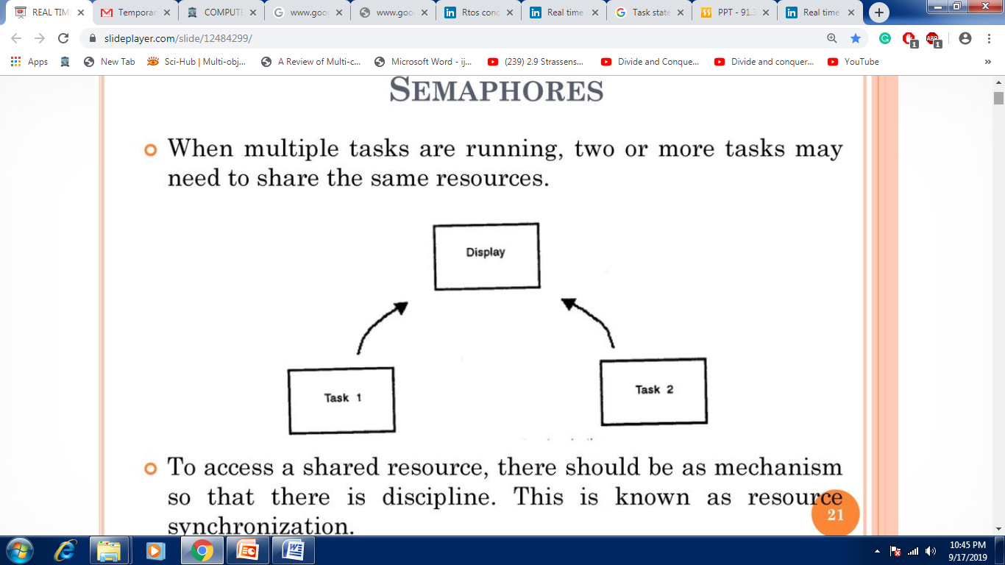
Semaphores
When multiple tasks are running, two or more tasks may need to share the same resources.
To access a shared resource, there should be as mechanism so that there is discipline. This is known as resource synchronization.

Slide 68
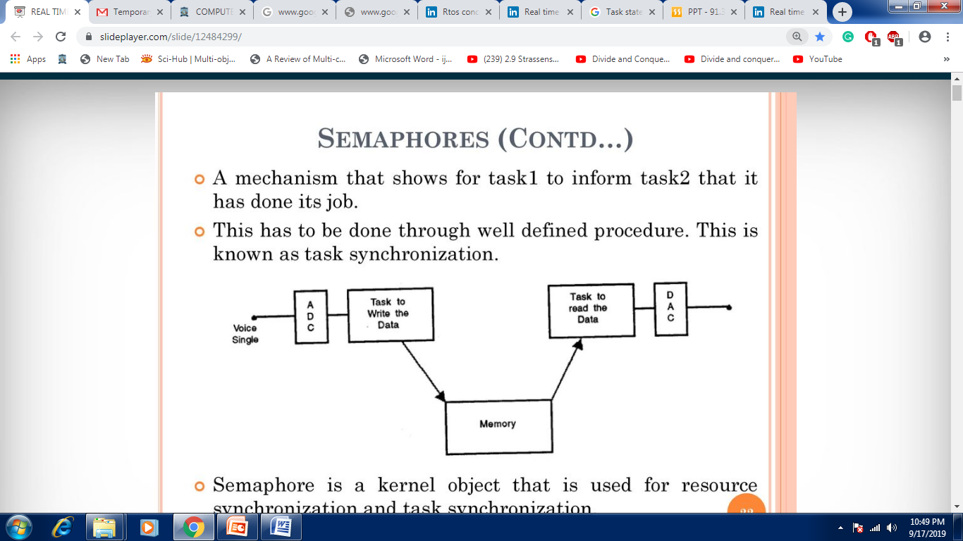
Semaphores
A mechanism that shows for task1 to inform task2 that it has done its job.
This has to be done through well defined procedure. This is known as task synchronization.
Semaphore is a kernel object that is used for resource synchronization and task synchronization.

Slide 69
Semaphores
Suppose two tasks want to access a display.
Display is shared resources. To control the access, a semaphore is created.
If a number of tasks have to access the same resources then the tasks are kept in a queue and each task can acquire the semaphore one by one.

Slide 70
MUTEX
Mutex is the general mechanism used for both resource synchronization as well as task synchronization.
Mutual exclusion can be achieved through the following mechanisms:
Disabling the scheduler
Disabling the interrupts
By test – and – set operations
Using the semaphore Test-and set operations
When two tasks have to share resource, the functions in each of the tasks can check the value of a global variable to obtain the status of the shared resources.
Note that while the test-and set operation is in progress, the interrupts have to be disabled. So, the procedure is – disable the interrupt, set the variable, access the shared resources, set the variable and lastly enable the interrupts.

Slide 71
MUTEX (Contd…) The mutex is a special binary semaphore.
A mutex can be either in locked state or unlocked state.
It is much more powerful than semaphore because of its special features:
It will have an owner, owner can acquire a mutex multiple times in the locked state.
If the owner locks it ‘n’ times, the owner has to release it ‘n’ times. A task owning a mutex, cannot be deleted.
The mutex supports priority inheritance protocol to avoid priority inversion problem.

Slide 72
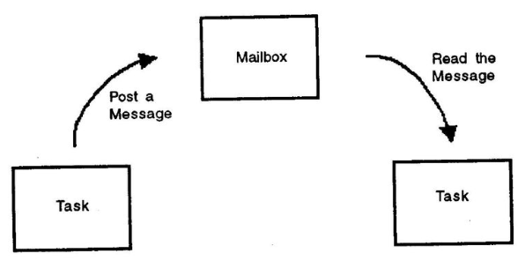
Mailboxes
A mailbox object is just like your mailbox
A task can have a mailbox into which others can post a mail.

Slide 73
Mailboxes (Contd…)
To manage the mailbox object, the following function calls are provided in the operating system API:
Create a mailbox
Delete a mailbox
Query a mailbox
Post a message in a mailbox
Read a message from a mailbox

Slide 74
Message queue
Message queue can be considered as an array of mailboxes.
Some of the applications of message queue are:
taking the i/p from a keyboard,
to display output,
reading voltages from sensors,
data packet transmission in a network.
In each applications, a task or an ISR deposits the message in the message queue. Other task can take the messages. At the time of creating a queue, the queue is given a name or ID, queue length, sending task waiting list and receiving task waiting list.

Slide 75
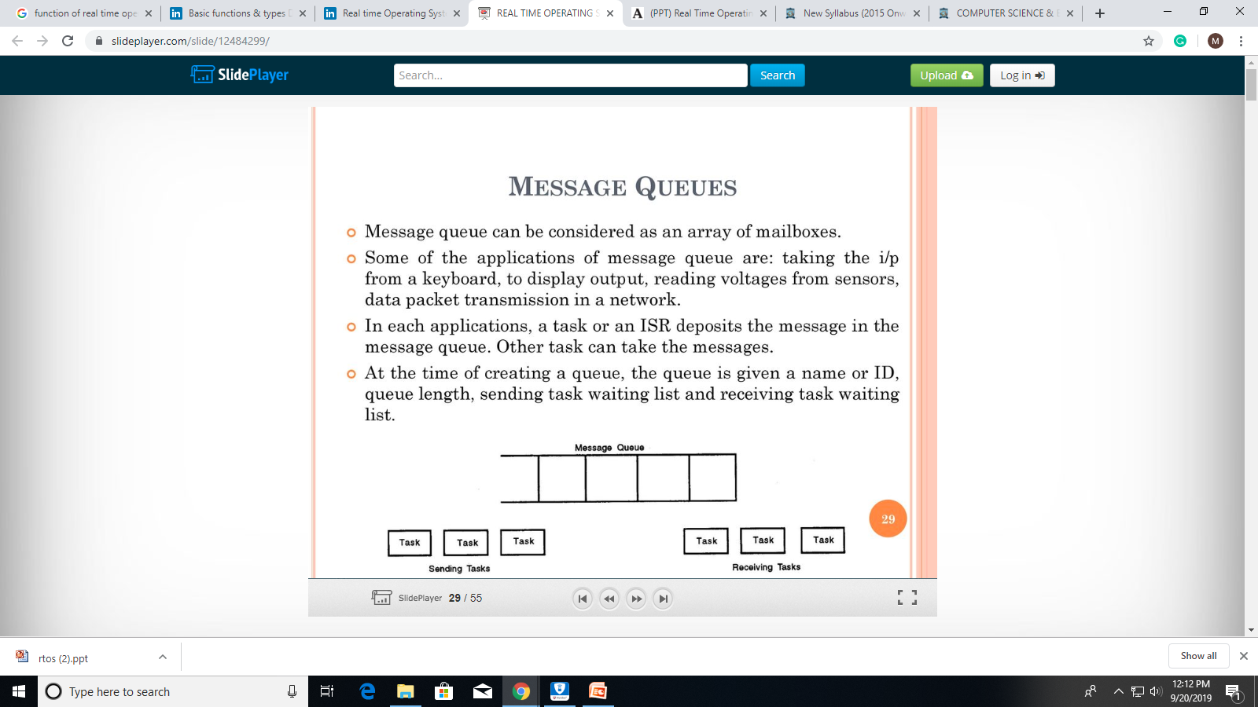
Message queue

Slide 76
Message queue
The following function are provided to manage the message queues:
Create a queue
Delete a queue
Flush a queue
Post a message in queue
Read a message from queue
Broadcast a message
Show queue information
Show queue waiting list

Slide 77
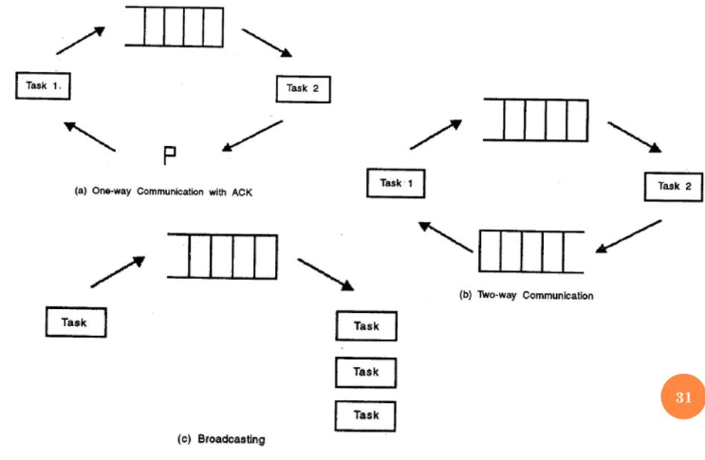
Message queue

Slide 78
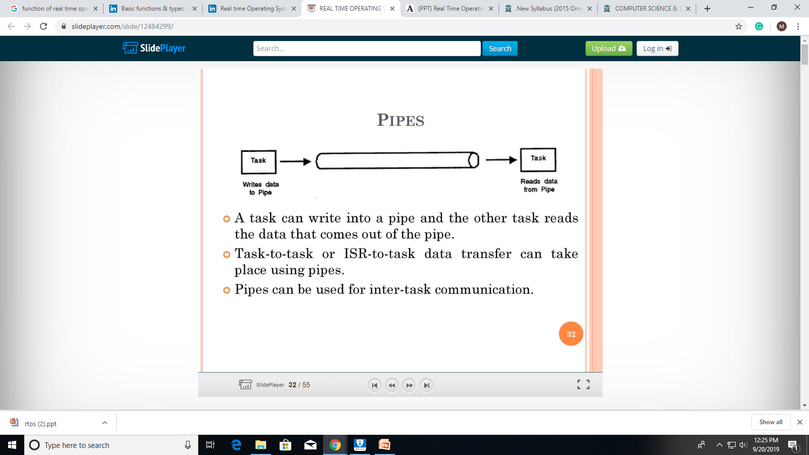
Pipes
A task can write into a pipe and the other task reads the data that comes out of the pipe.
Task-to-task or ISR-to-task data transfer can take place using pipes. Pipes can be used for inter-task communication.

Slide 79
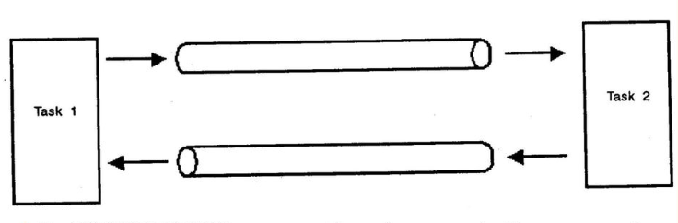
Pipes
In UNIX/LINUX, we use the pipes as shell commands. Consider the shell command $ cat hello.c | more

Slide 80
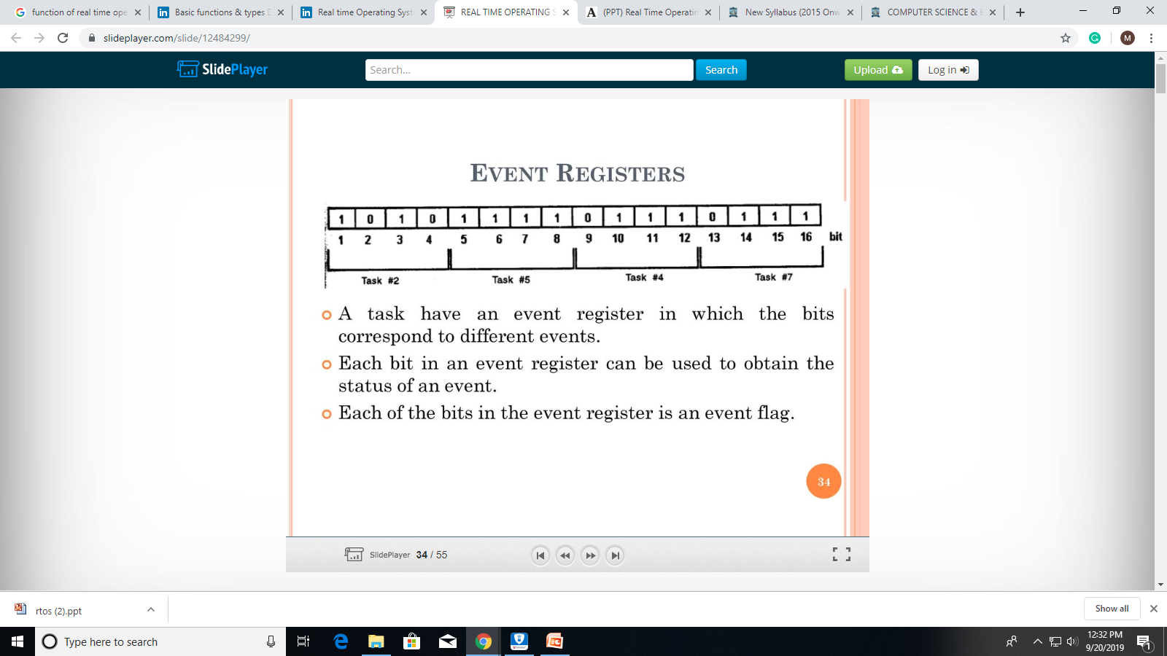
Event Registers
A task have an event register in which the bits correspond to different events.
Each bit in an event register can be used to obtain the status of an event.Each
of the bits in the event register is an event flag.

Slide 81
Signals
Signals can be passed to indicate an event Many RTOS do not support it then and their use is discouraged.
In shell commands, the signals are sent to kill a process. Consider the command $kill

Slide 82
Timers
Timers are used to measure the elapsed time of events. The kernel has to keep track of different times:
A particular task may need to be executed periodically. A timer is used to keep track of the periodicity.
A task may be waiting in a queue for an event to occur.
If the event does not occur for a specified time, it has to take the appropriate action.
A task may be waiting in a queue for a shared resource. If the resource is not available for a specified time, an appropriate action has to be taken.
Timer management function calls: Get time Set time TimeReset timer

